Slide 1
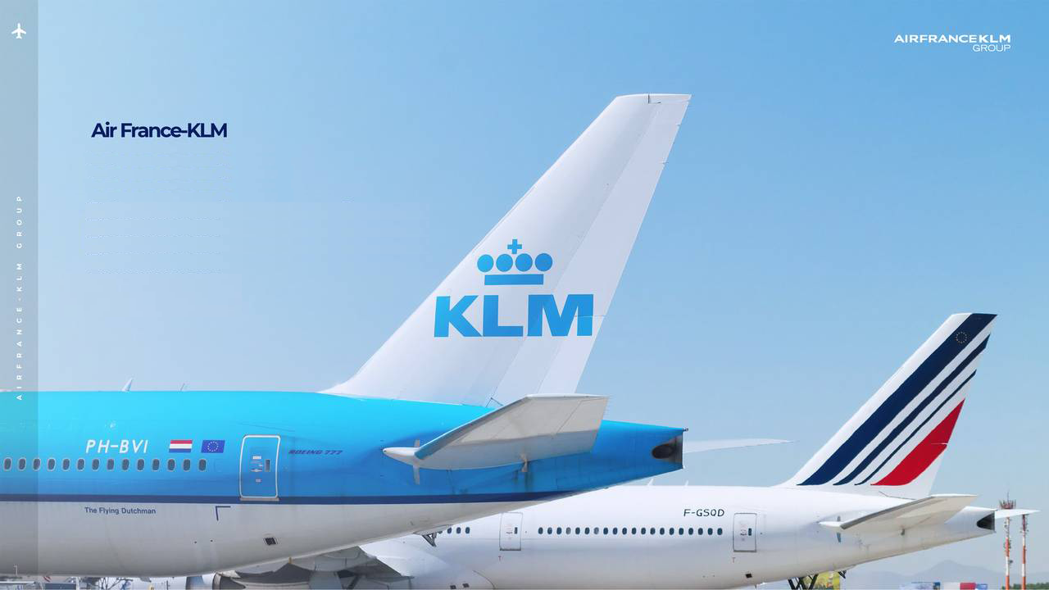
Internet Marketing
Search Engine Optimization
23 November 2019
Team 10

Slide 2






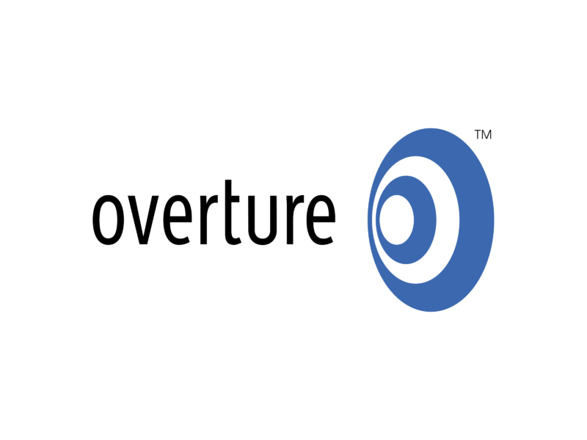

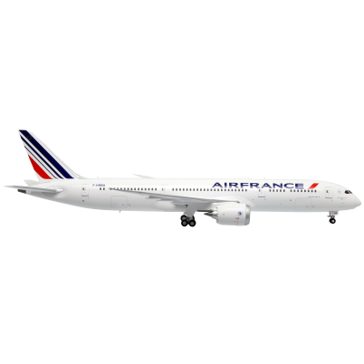
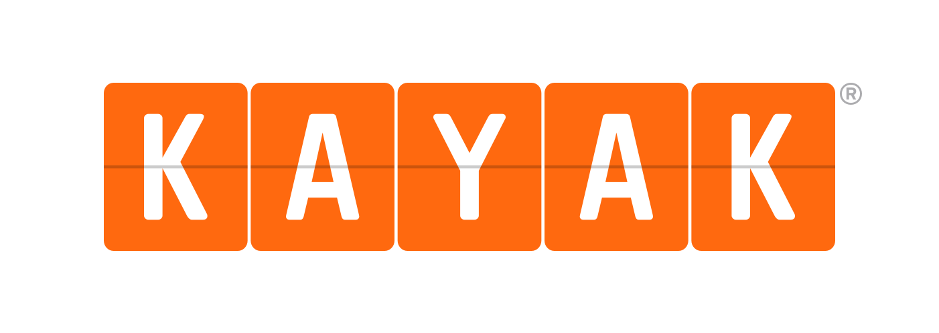

Business Problem
Competitive Business
Internet Marketing
Search Engine Optimization

Slide 3



Business Goal
Profit Optimization
Reduce
Cost
Improve
PR

Slide 4
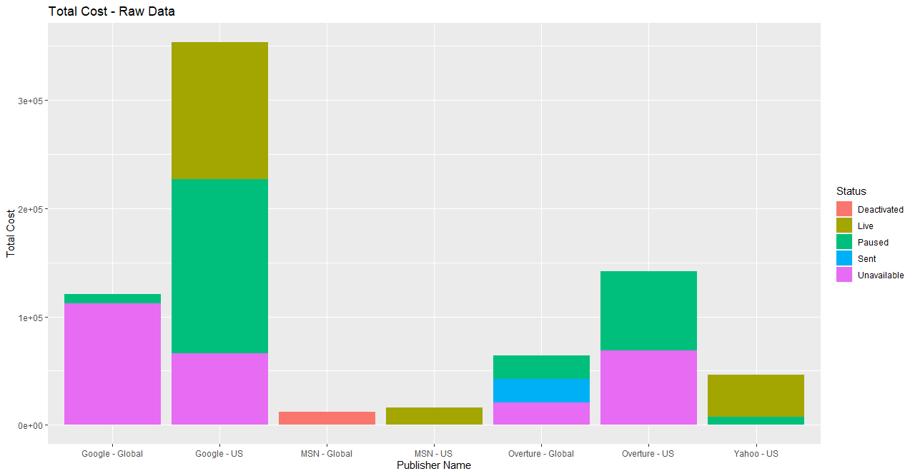
Raw Data Total Cost
Notes:
Case Example of Raw Data

Slide 5
Key Data Rubbing
Data Type | Original Data | Filtered (Profit > 0) | Filtered (Top 80% Profit Generator)
# of Observations | 4510 | 324 | 65
Notes:
Methodology on Gaining Insights

Slide 6
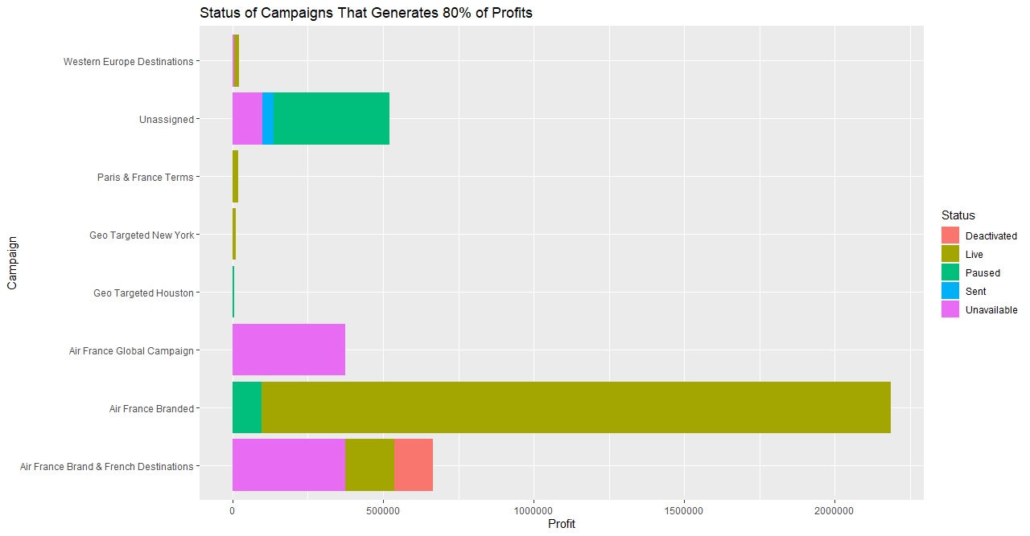
Notes:
Need to reactivate these campaigns to optimize profit

Slide 7
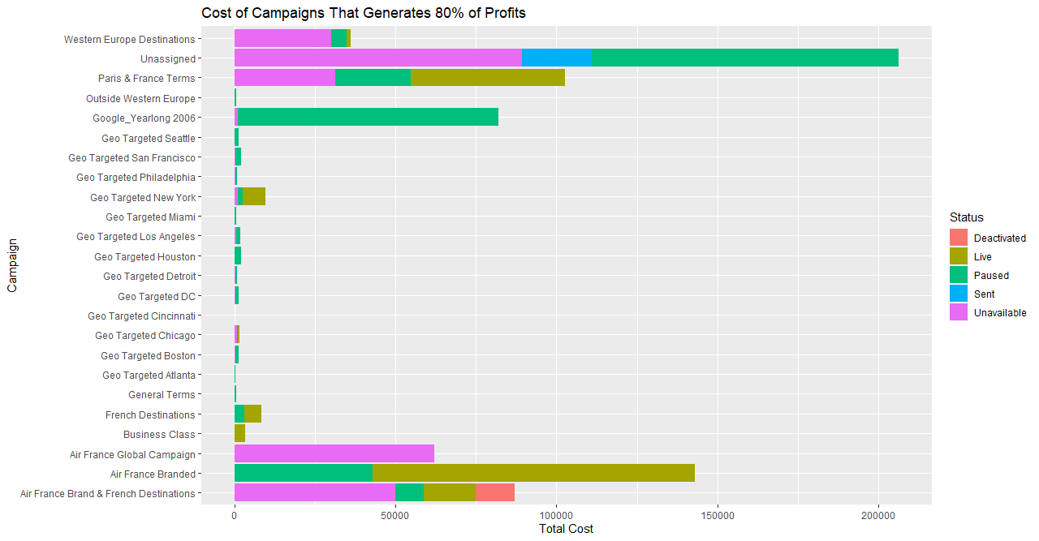
Notes:
From the cost point of view

Slide 8
Highlights
Campaign Name | Status | Profit | Total Cost
Air France Branded | Live | $ 2,088,096.00 | $ 95,748.02
 | Paused | $ 97,452.35 | $ 42,135.5
Paris & France Terms | Live | $ 19,243.99 | $ 18,607.37
 | Unavailable | $ 0 | $ 11,323.79
 | Paused | $ 0 | $ 1,854.412
$ 2,185,548.35
↑ ☺
$ 137,883.52
↓ ☺
$ 19,243.99
↓ ☹
$ 31,785.572
↑ ☹

Slide 9
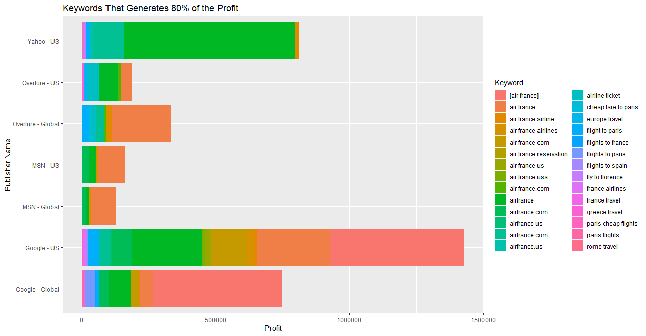
Key Keywords
air france ~2.9 M
airline ticket
+ Keywords on Pink Scale
Strong Correlations
Notes:
Notes:
The Graph we are observing now is the Publishers against the profit. As previously explained we are only focusing on the keywords contributing to 80%.
The aim of the graph is to understand which keywords are used most by the publisher and the profits associated to it.
The firm AIR FRANCE is interested in increasing PR and market share in US market hence focusing or prioritizing on the keywords for each publishers help meet the goal of the Air France.
Correlation observed between impression and profits generated for publishers Yahoo -US and MSN -US and MSN- Global.
Upon careful examination we can observe that the Air France Branded Keywords(in red , orange or the same column) tend to generate the most profits to the company. It was also mentioned in the case study about the brand name keywords contributes the most profits to the company.
An interesting keyword observed was the airline ticket. It can be seen in yahoo and overture. We need to focus on the other keywords (in pink) to maximise profits (These are france travel, spain travel etc) and keywords such as airline tickets in blue are significant as they contributed to top 20% of profit.

Slide 10
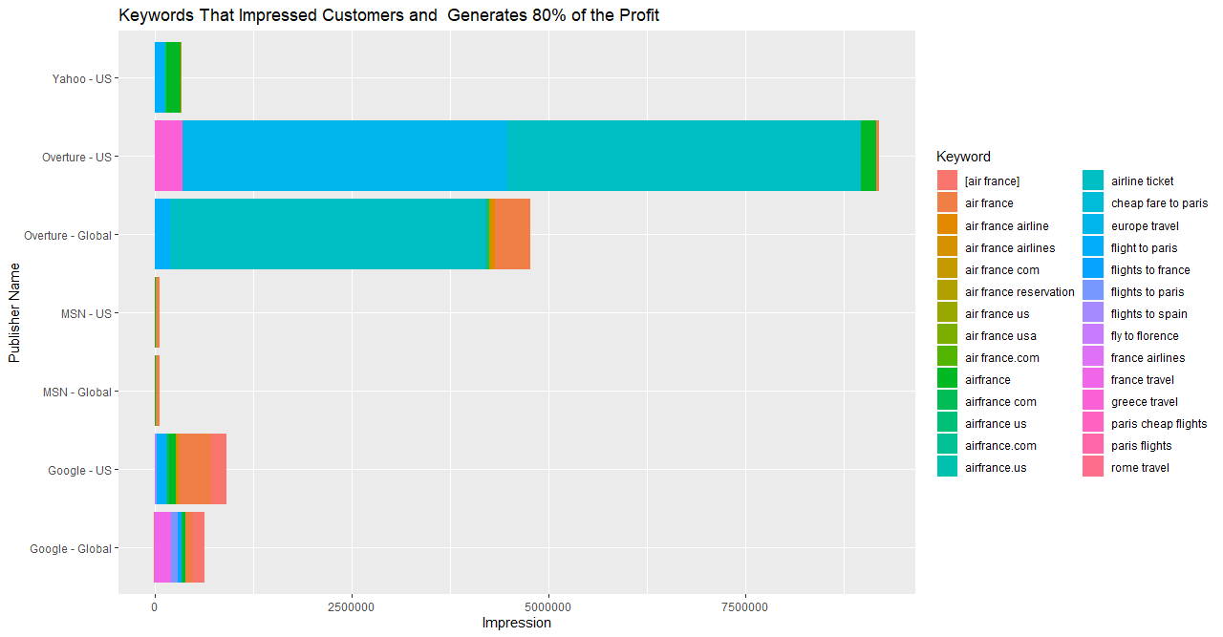
Key Keywords
air france~ 1.9 M
airline ticket ~ 8.5M
+ Keywords on Pink Scale
Strong Correlations
Engine Click Thru vs Conversion Rate for Overture
Notes:
Notes:
The Graph we are observing now is the Publishers against the impression. As previously explained we are only focusing on the keywords contributing to top 80%.
The aim of the graph is to understand which keywords are used most by the publisher and the impressions associated to it.
Correlation observed between impression and profits generated for publishers Yahoo -US and MSN -US and MSN- Global.
Unlike the trend observed before, we see that the keywords that generate the most impressions is airline ticket and cheap fare to paris.
The pink scale associated to france travel greece travel, etc also contribute to impressions in small numbers. A correlation was observed between engine click through rate and conversion rate in overture publisher which means that if a person sees an ad he/she is more likely to click it and convert as a customer for Airfrance.

Slide 11
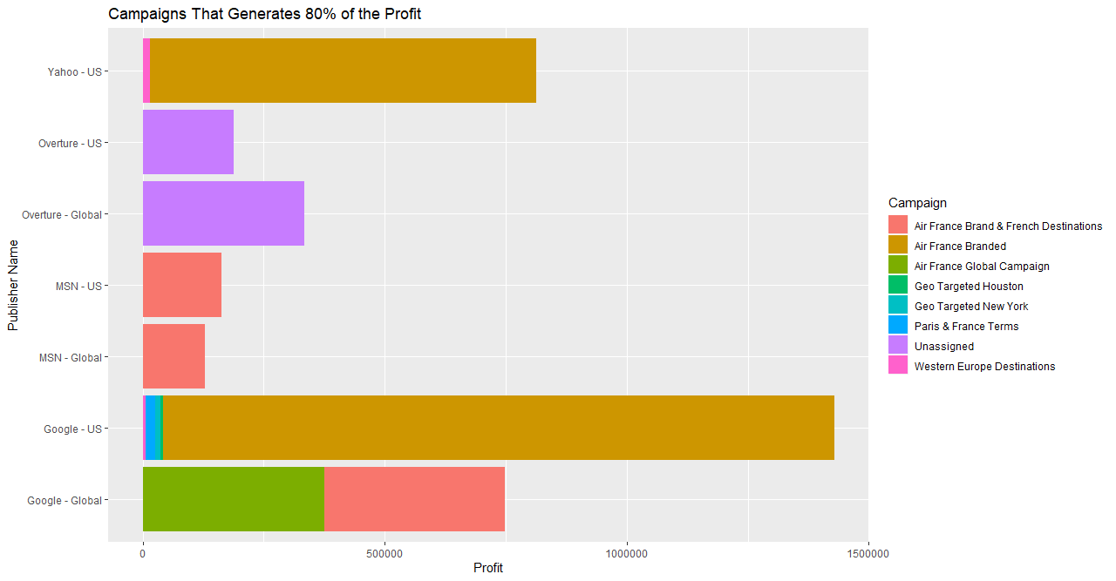
Key Campaigns
Air France ~ 2.1M
Unassigned
Western Europe Destination
Strong Correlations
Notes:
Notes:
The Graph we are observing is the Publishers against the profit. As previously explained we are only focusing on the campaigns contributing to 80%.
Correlation observed between impression and profits generated for publishers Yahoo -US and MSN -US and MSN- Global
The firm AIR FRANCE is interested in increasing PR and market share in US market hence focusing or prioritizing on the campaigns in these particular publishers help meet the goal of the publisher.
Upon careful examination we can observe that the Air France Branded campaigns tend to generate the most profits to the company.
Campaigns by Google US and Yahoo US generates the most profits
Overturer does not have a specific campaign assigned but produces profits just after Yahoo US and google US.
Campaigns run by MSN US and MSN Global tend to contribute to the top 20% of the profit but as Jose mentioned before they have deactivated it. Upon activating this it can help generate profits or in other words, the consumer entering the website through this particular campaign are more likely to make a purchase(and bring revenue to company).
A logistic regression was conducted between profit (a dependent variable and independent variables such as impressions and engine click through) which was significant.

Slide 12
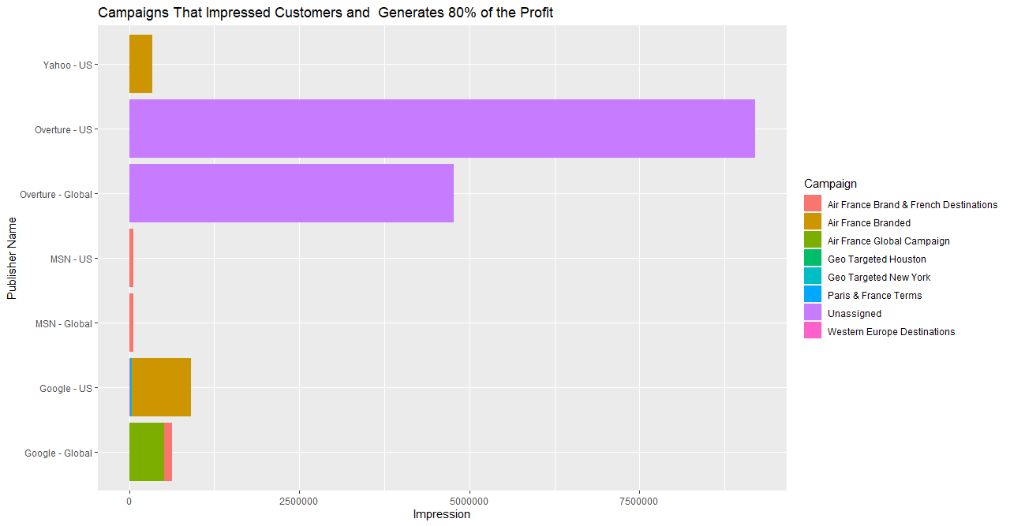
Key Campaigns
Air France Branded
Unassigned ~ 13.9M
Western Europe Destination
Strong Correlations
Engine Click Thru vs Conversion Rate for Overture
Notes:
Notes:
The Graph we are observing now is the Publishers against the impression. As previously explained we are only focusing on the campaign contributing to 80%.
Correlation observed between impression and profits generated for publishers Yahoo -US and MSN -US and MSN- Global.
The aim of the graph is to understand which campaign are used most by the publisher and the impressions associated to it.
Unlike the trend observed before, we see that the keywords that generate the most impressions is unassigned but contributes the most impressions(ability to view). A correlation was observed between engine click through rate and conversion rate in overture publisher which means that if a person sees an ad he/she is more likely to click it and convert as a customer for Airfrance.
90 % of ads in Overture are published on other search engines.

Slide 13
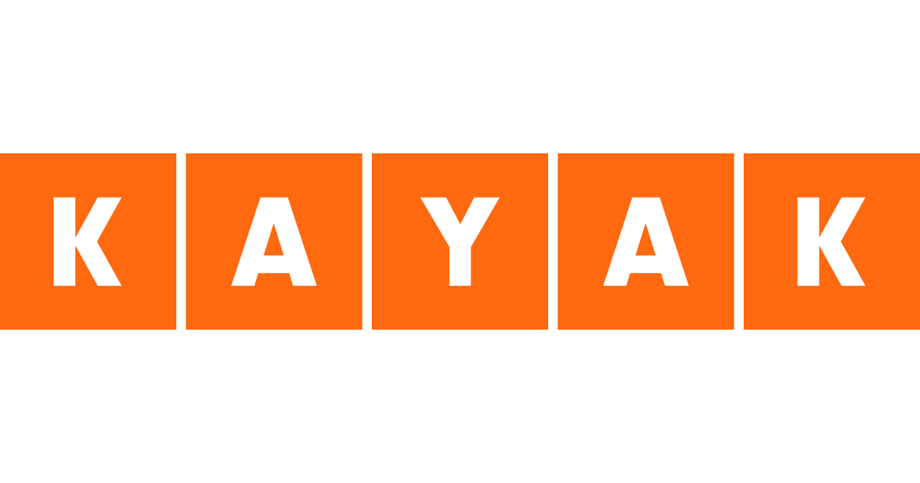
Metasearcher
Separate analysis
Exhaustive search

Slide 14
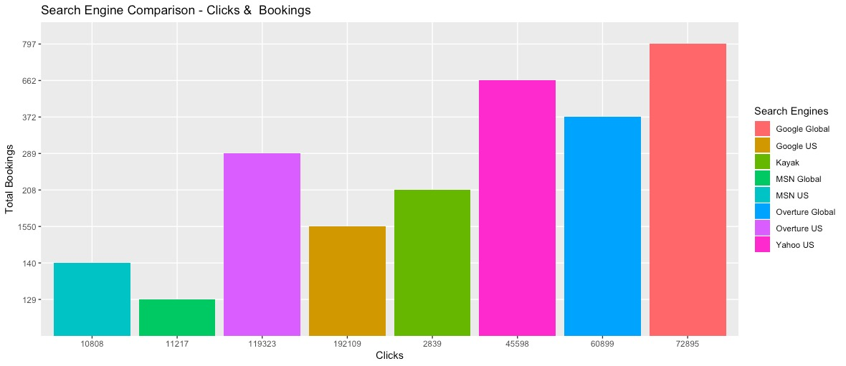



Slide 15
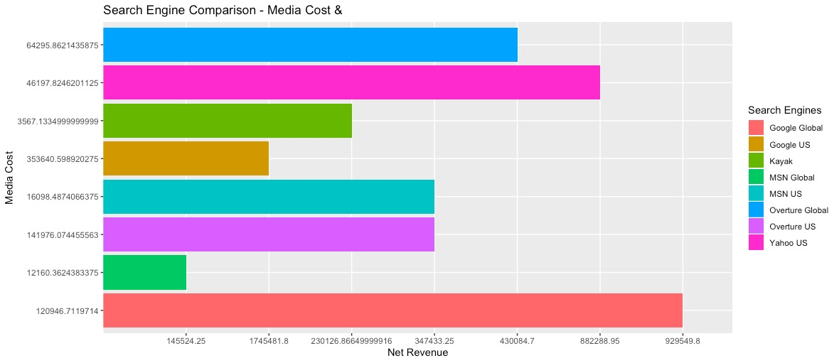

Slide 16
Summary & Recommendation
Tailor each publisher strategy to maximize ROA
Focus on top 80% profit contribution
Increase brand awareness using identified effective keywords and campaigns
Notes:
Notes:
We Focused on the most important metric such as profit and impressions that contributes to the business goal and benchmarking it against other metrics such as campaigns and keywords per publisher. We observed that a uniform mix between each publisher will not support our business case as each publisher behave differently.
We can leverage or optimize profits by focusing on what contributed to top 80% of profit and enhancing it.
We can avoid or reduce costs by assigning little to no resources to the campaigns and keywords that did not contribute much to the firm.
Increasing brand awareness can be attained by focusing on the keywords or campaigns which converted more customers but had less impressions.
We strongly feel that we can consider Kayak in the near future but first focusing on leveraging those existing segments which contributed most to generating profits has to be made.

Slide 17

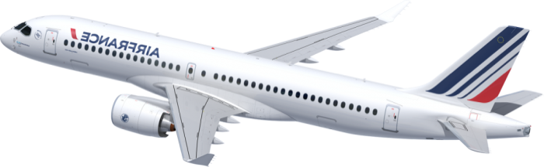


Slide 18
Appendix

Slide 19
High-level Analysis Process
Analysis per Publisher
Getting Dataset Ready
Data Massaging
Correlations
Regression
Comparison
Findings and Insights
New Variables
Conditions
Converting
Analysis on a whole

Slide 20
Key Steps Process Breakdown
Create a new column Profit = Revenue - Cost
Subset Profit > 0
Understand how many (%) keywords are associated to generating 80% of the Profit
Subset Publishers → Check → Campaigns → Keywords
Subset → those data associated with quantile (.80) Profit
Check correlations: metrics per Publisher (Profit, Impressions, Conversion Rate, Engine Click Through etc.)
Come up with observations and conclusions

Slide 21
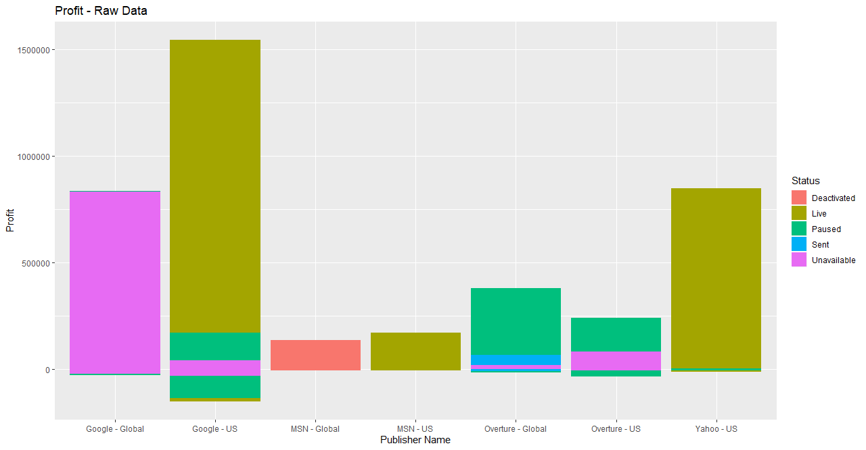
Raw Data Profit

Slide 22
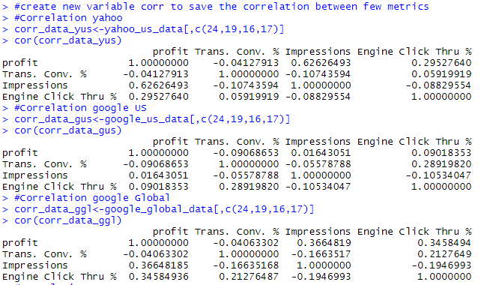
Correlation

Slide 23
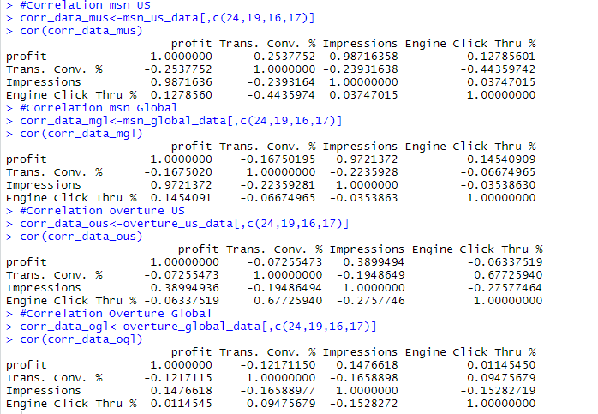
Correlation

Slide 24
References
Egli, L., Lambert, J., Neely, L., Gieraltowski, A., Miller, J., Sharma, R. (2009). Air France Internet Marketing: Optimizing Google, Yahoo!, MSN, and Kayak Sponsored Search. Case Number: 5-407-753. Evanston, IL : Kellogg Case Publishing, Northwestern University.
Travel Weekly. (2012, August 3). 80% booking holidays online, finds study. Travel Weekly. Retrieved from: http://www.travelweekly.co.uk/articles/41280/80-booking-holidays-online-finds-study.
Deloitte. (n.d.). Managing strategic risk in aviation. Deloitte. Retrieved from: https://www2.deloitte.com/us/en/pages/consumer-business/articles/disrupt-aviation.html.
Sullivan, D. (2002, March 4). How Overture (GoTo) Works. Search Engine Watch. Retrieved from: https://www.searchenginewatch.com/2002/03/04/how-overture-goto-works/.
Hillhouse, E. (2018, October 17). Come Fly with Me: The Art of Airline Public Relations. Platform Magazine. Retrieved from: https://platformmagazine.org/2018/10/18/come-fly-with-me-the-art-of-airline-public-relations/.
SVB. (2007, December 21). KAYAK.COM MERGES WITH SIDESTEP.COM; SECURES $196M IN FINANCING ROUND. SVB. Retrieved from: https://ir.svb.com/news-releases/news-release-details/kayakcom-merges-sidestepcom-secures-196m-financing-round.

